Slide 1
Effective Ways
to select a Dataset
from Large Corpus
여진영 교수님
김주찬, 김유진, Dobreva Iva

Slide 2

1
Subject
2
Graph
Implementation
3
Influence
Maximization
4
Training Result

Slide 3


Subject
Subject
Data Selection with Influence Maximization
CEDR

Slide 4
Subject
Process
Graph
IMP
Training
Transform list data
into graph
Influence Maximization
with TIM
Use seed dataset
as a input of CEDR

Slide 5


Graph Implementation
Structure
Node
Edge
Document data (doc_id)
Attributes: query_id, rel_1d
Q(q);: all queries that both node participate in
If n(Q) $>$ 0 : connect the edge
Weight:: ∑ rel_1d(q) / n(Q)
Rel_1d:
1 if query and document is related

Slide 6
Graph Implementation
Implementation
Method 1
Method 2
Step 1: create nodes
Step 2: calculate weight between
each nodes
Step 3: connect related nodes
- Conclusion: takes several hours to be done (around 7 hours)
Step 1: create nodes
Step 2: make list of all edges
Step 3: connect related nodes at once
- Conclusion: failed in allocating memory for excessive amount of edges

Slide 7

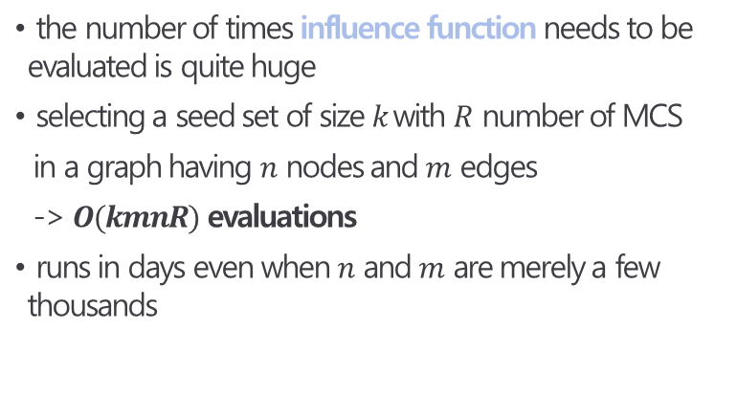
Influence Maximization
How to solve
Greedy
Algorithm
Kempe et al.
the number of times influence function needs to be evaluated is quite huge
selecting a seed set of size $k$with $R$ number of MCS
in a graph having $n$ nodes and $m$ edges
-> $O(kmnR)$ evaluations
runs in days even when $n$ and $m$ are merely a few thousands
TIM+
$O(kmn∙poly({\text{ε}}^{−1}$) -> $O\left(k+l\right)\left(m+n\right)logn/{\text{ε}}^{2}$

Slide 8
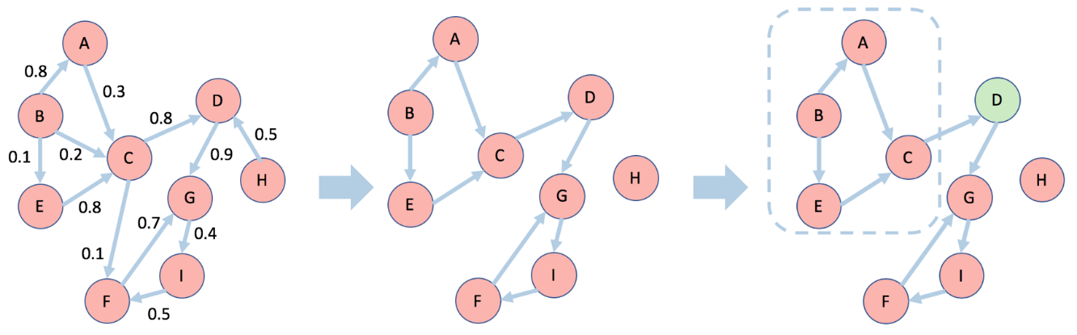
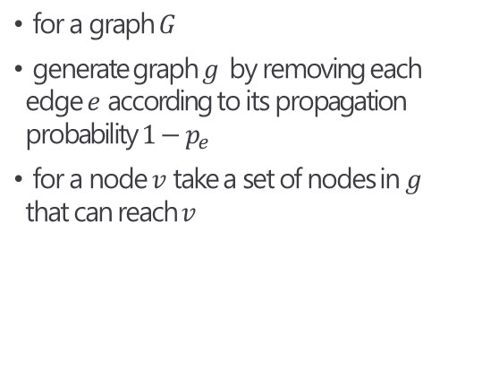
Influence Maximization
Reverse Influence Sampling(RIS)
Reverse Reachable(RR) Set
for a graph $G$
generate graph $g$ by removing each edge $e$ according to its propagation probability $1−p_{e}$
for a node $v$ take a set of nodes in $g$ that can reach $v$
Select 𝑘 nodes
to cover the maximum number of RR sets in 𝑅 using the standard greedy algorithm
Generate a set 𝑅
of many
independent RR sets

Slide 9
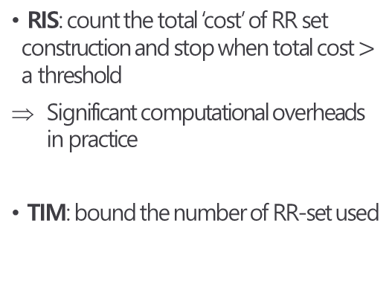
Influence Maximization
Two-phase Influence Maximization(TIM)
How many RR sets?
Parameter
Estimation
Node
Selection
RIS: count the total ‘cost’ of RR set construction and stop when total cost $>$ a threshold
Significant computational overheads in practice
TIM: bound the number of RR-set used
Intermediate step :
improve parameter estimation
TIM+

Slide 10
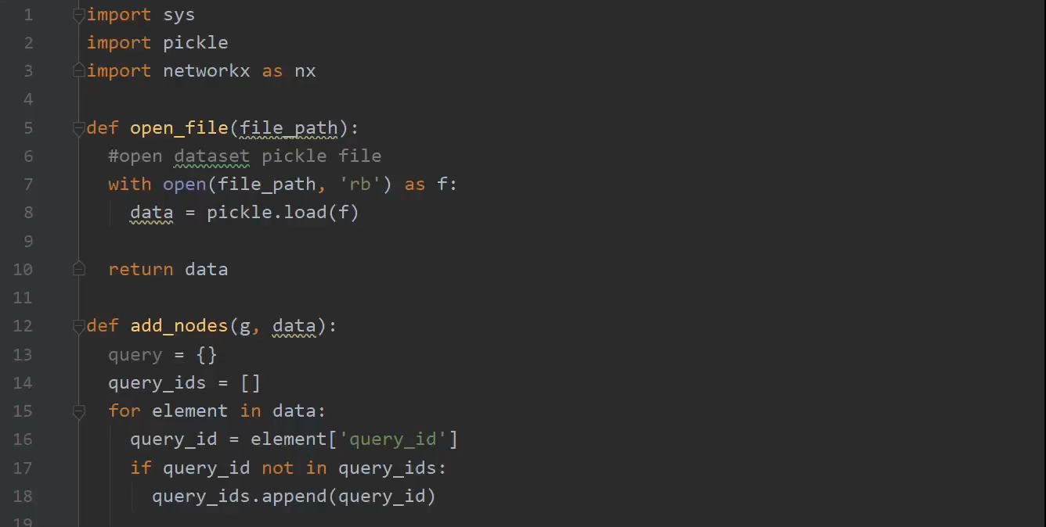
Training Result
Video clip

Slide 11
Training Result
MAP comparison
Result
dataset reduction:
110,000 -> 50,000
training time decreased:
11 hours -> 6 hours
accuracy improved

